Slide 1
Course Project
Topic：A B C D
Team member：徐薛楠 周之恺 马达 吕波尔
2019.12.25

Slide 2
How does the influence the smoothness of the loss function
sample size
depth of network
number of iterations
Topic A B C

Slide 3
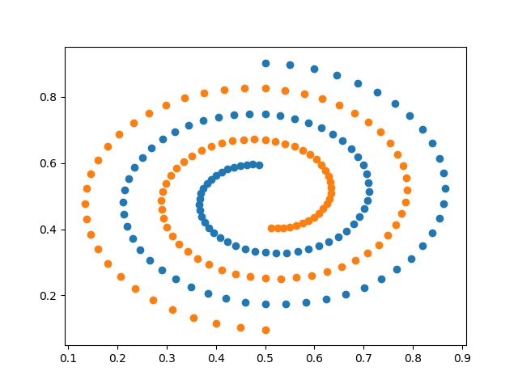
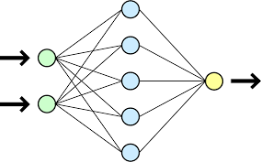
Dataset and network architecture
binary classification
FNN with RELU activation

Slide 4
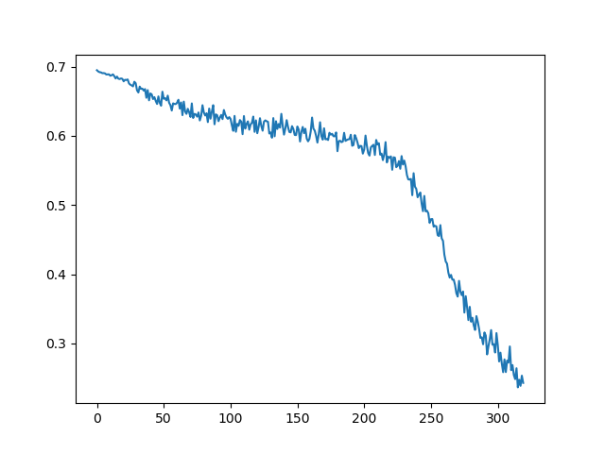
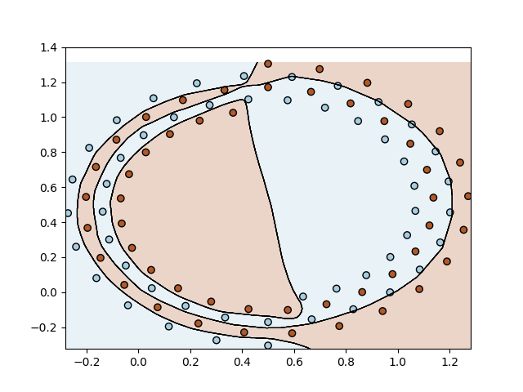
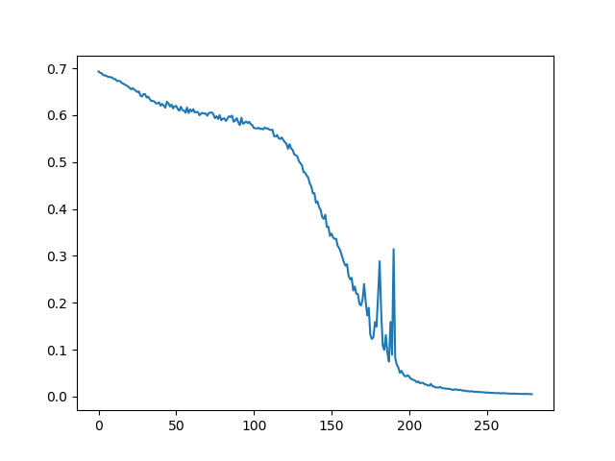
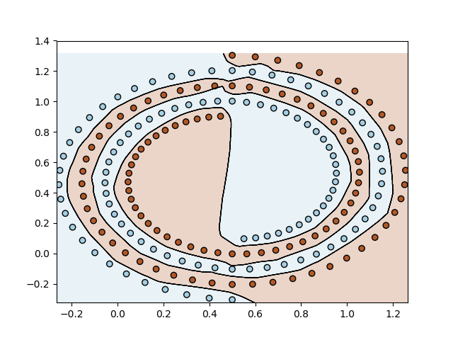
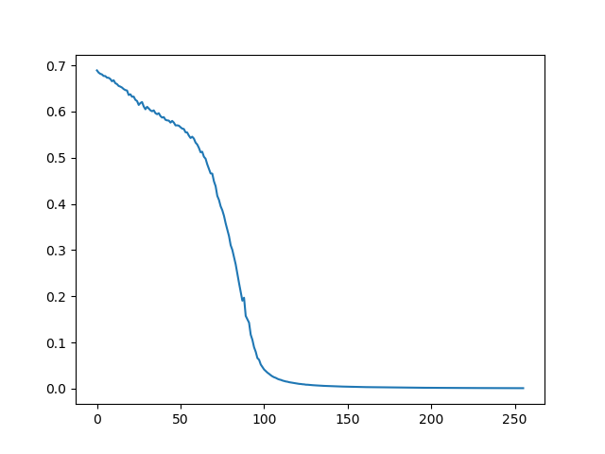
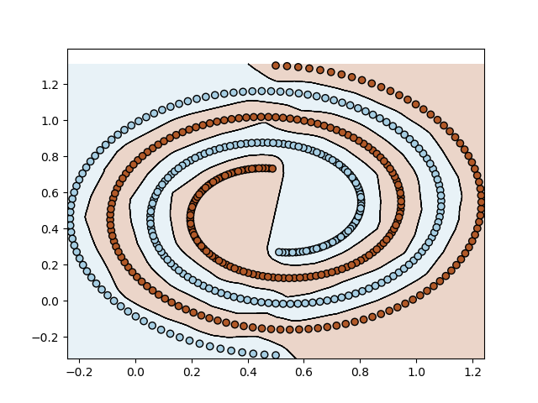
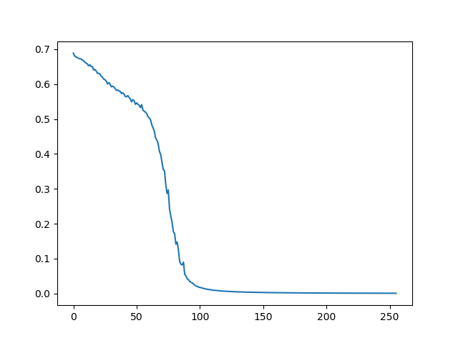
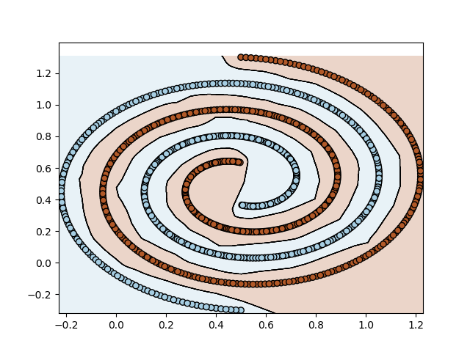
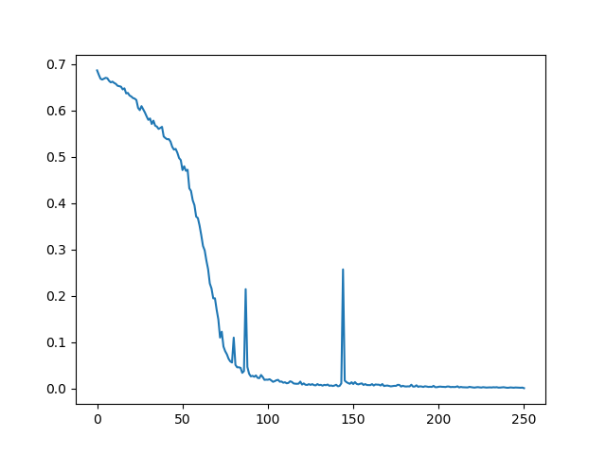
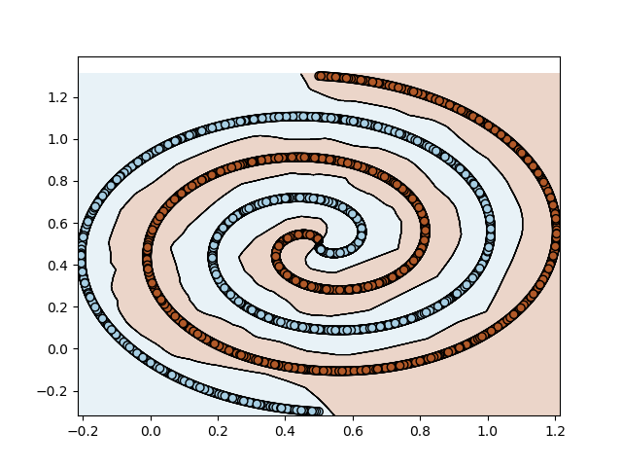
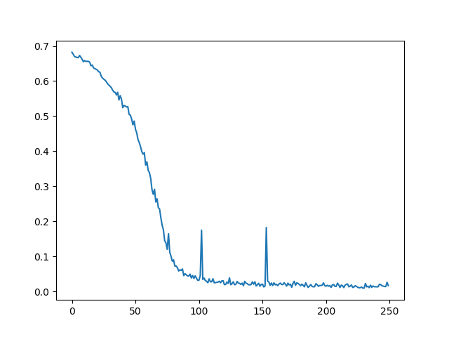

Topic A: the influence of the sample size
100
200
500
1000
10000
100000
The average loss fluctuates seriously when the sample size is small. As the sample size increases, the model
converges earlier. However, some more local optimums appear if the sample size is too large.

Slide 5
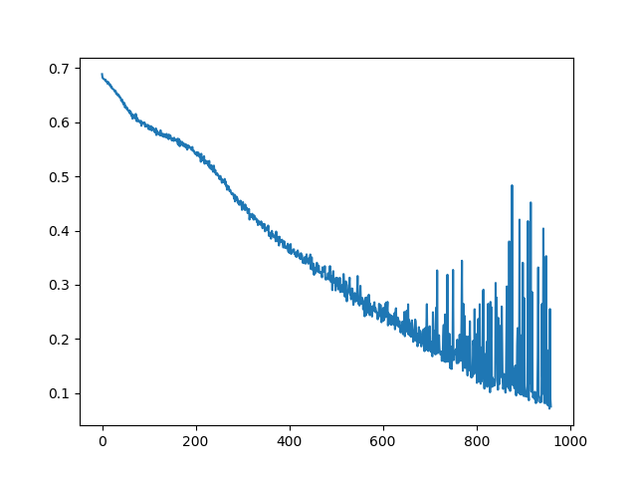
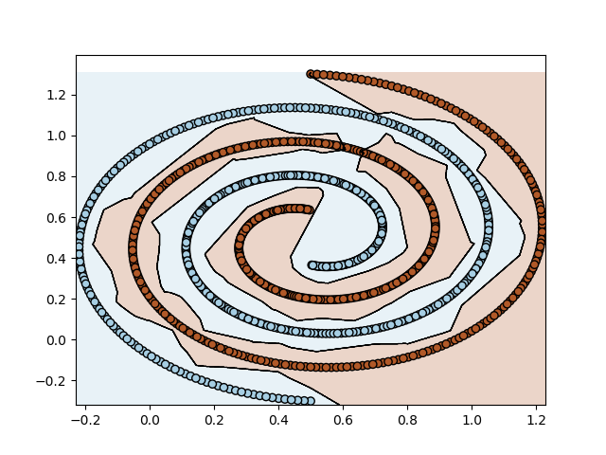
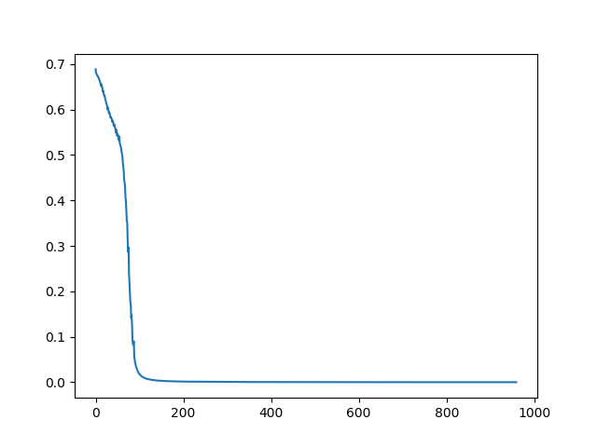
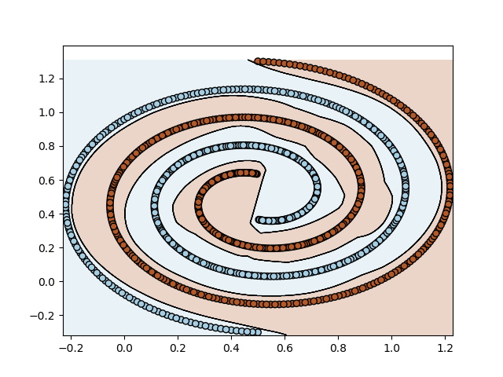
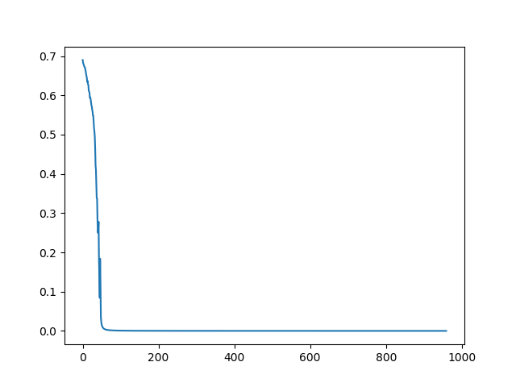
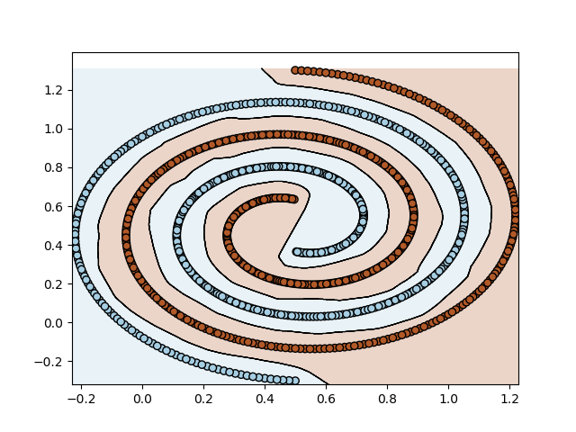
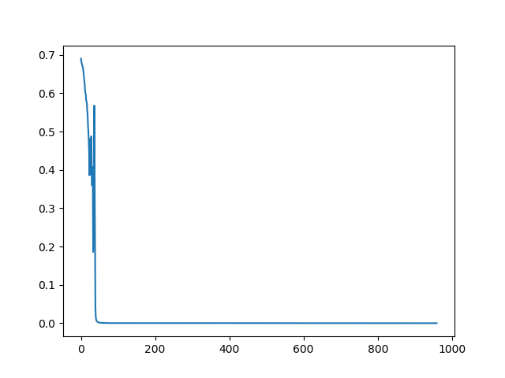
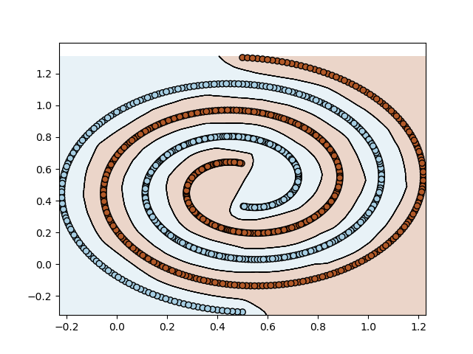
Topic B: the influence of the depth
2
3
4
5
The average loss fluctuates seriously near the global optimum with shallow depth. Similarly, the average
is more smooth as the depth increase but with small fluctuation when the depth is too deep.

Slide 6
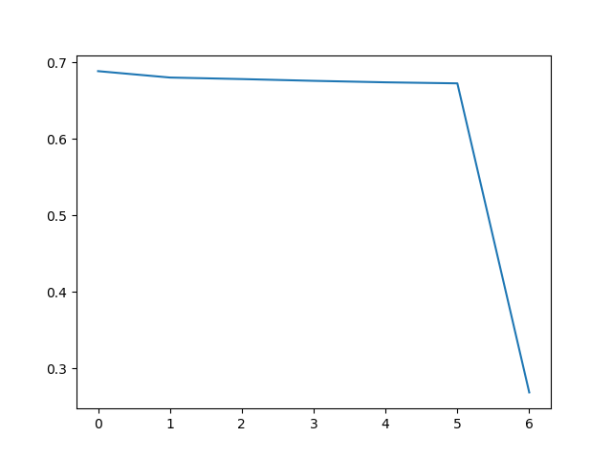
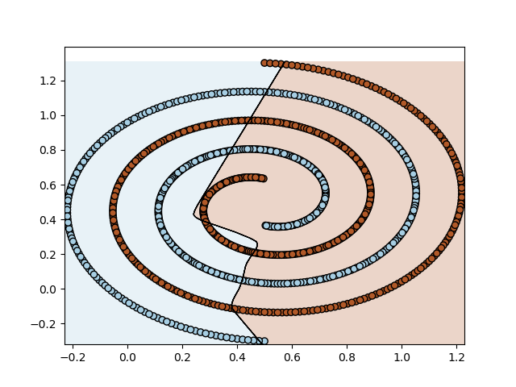
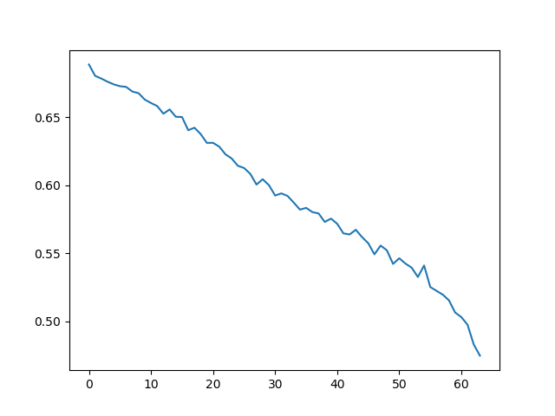
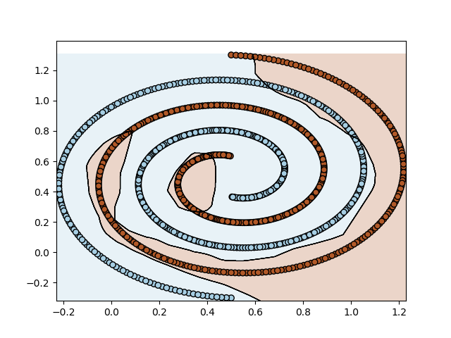
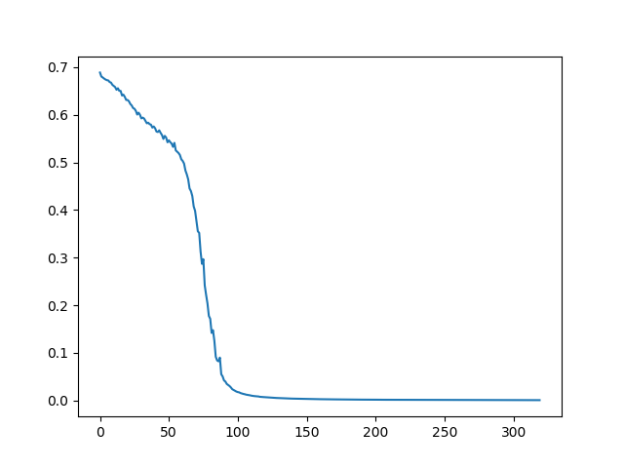
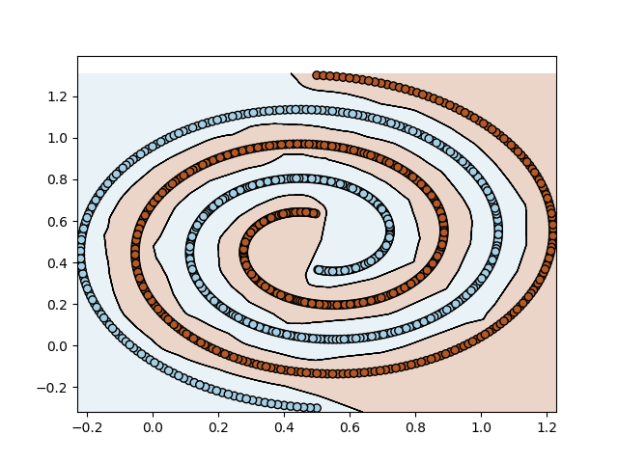
Topic C: the influence of the number of iterations
20
200
1000
3000
When the model converges, the iteration number has no influence.

Slide 7
The Experiment of Bi-directional Learning on Phoneme Recognition
Topic D
Notes:
Today I would like to talk about the experiment of bi-directional learning on phoneme recognition

Slide 8
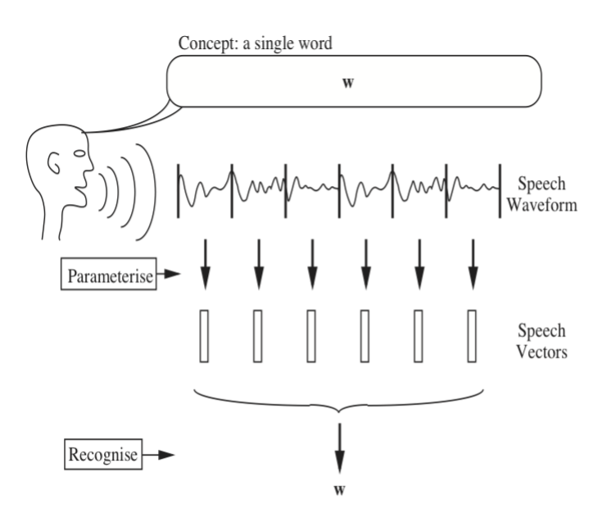
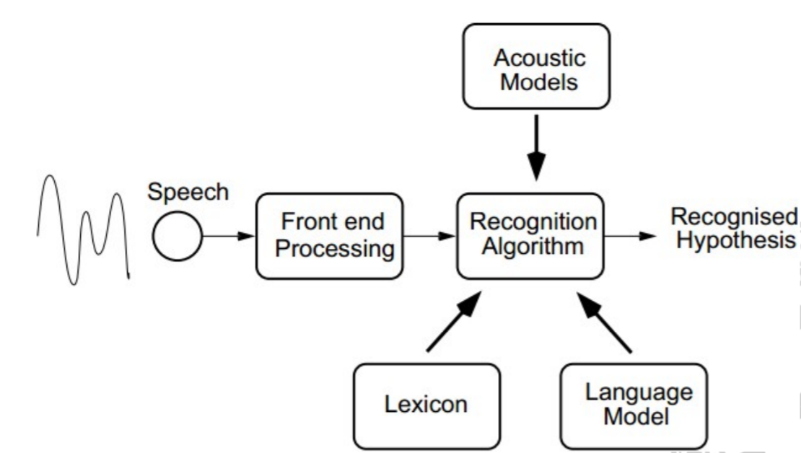
Brief Introduction of Speech Recognition
WHAT DOES LANGUAGE MODEL DO?
too? [tu]
two?
There are too rabbits.
There are two rabbits.√
Notes:
Phoneme Recognition is a subtask of speech recognition.
As we all know, speech recognition systems take speech waveform as input and output the words and sentences.
The front end processing like feature extraction transform speech wav into vectors.
And then acoustic models recognize the vectors and output phoneme sequence.
At last language model with lexicon turns phoneme into word sequence.

Slide 9
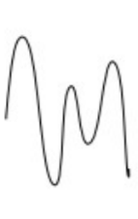
Why Phoneme Recognition?
Transcript: She had your dark suit in greasy wash water all year.
Phone sequence: h# sh ix hv eh dcl jh ih dcl d ah kcl k s ux q en gcl g r ix s ix w ao sh epi w ao dx axr ao l y ih axr h#
We have more than 171476 English words.(wordcounter.io)
More than 85568 Chinese characters. (《中华字海》)
BUT ONLY
39 phonemes( Lee&Hon, 1989)
About 1200 mandarin pinyins with pitch
410 pinyins without pitch
Notes:
Using phonemes to build an acoustic model is much feasible than direct words.
Nowadays , a lot of work is interested in end-to-end speech recognition benefits from the development of deep learning and growth of data volume.

Slide 10
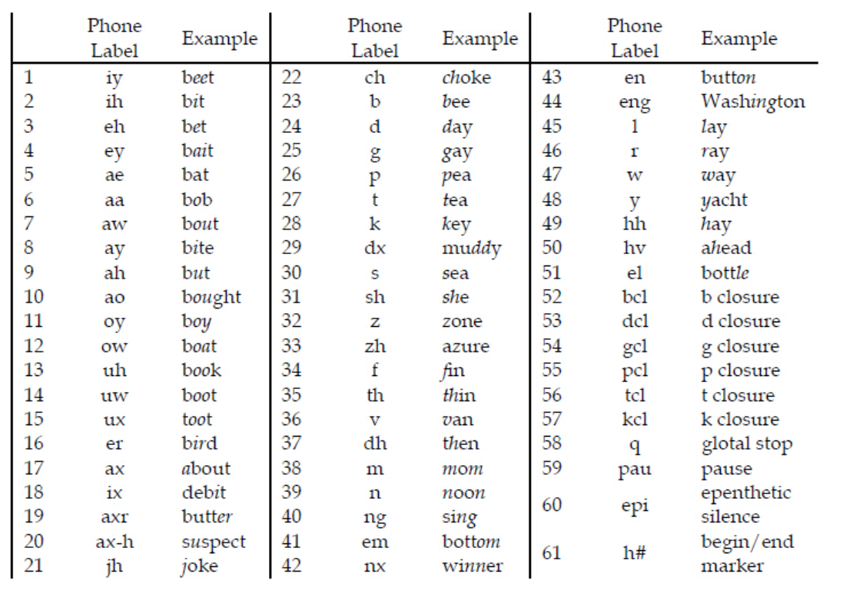
What we have done?
An acoustic model on TIMIT database using bi-directional learning.
Notes:
This is the table of 61 phonemes used in TIMIT database. And researchers map them into 48 phonemes because of the difficulty to distinguish them.

Slide 11
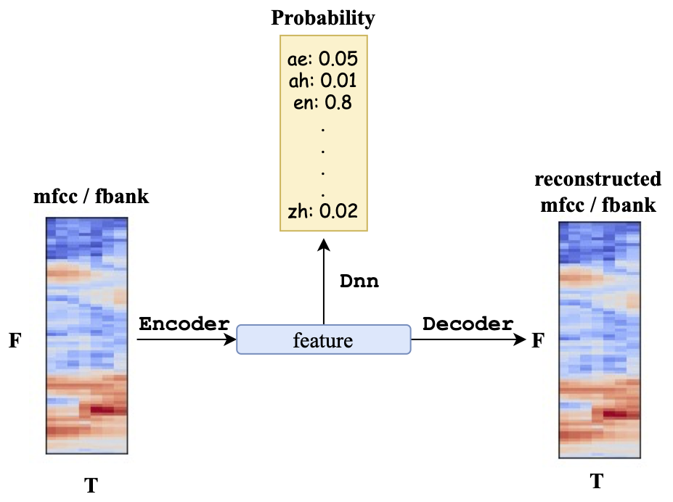
Model
Bidirectional learning:
feature extraction by autoencoder training
compare with features extracted by the encoder with the same architecture
output phone posterior

Slide 12
Model
Architecture -- DNN
Encoder: [2*context+1, F] → reshape (-1, 1) → 256 → 128 → 64
Decoder: symmetry architecture with encoder
Classifier DNN: 64 → 128 → 256 → 512 → 256 → 128 → 64 → 51

Slide 13


Results
Reconstruction:
Classification results:
random initialized dnn
autoencoder initilized encoder (fixed)
autoencoder initilized encoder (unfixed)
68.05%
67.22%
68.25%

Slide 14
Visualization
autoencoder extracted feature:
general dnn extracted feature:

Slide 15
Thank you

